Slide 1

Global Student Migration – Predictive Analytics
Analyzing international student trends using advanced data techniques

Slide 2
Introduction and Data Overview
Notes:
Introduction, Data Used

Slide 3

Introduction
Global Student Migration
  Millions of students migrate annually to countries like the US, UK, Canada, Australia, and UAE for education and opportunities.
Factors Driving Migration
  Academic quality, career prospects, financial aid, and post-study work policies motivate international student migration.
Predictive Analytics Project
  The project uses data analytics to forecast student migration trends and assess impacts of disruptions like COVID-19.
Policy and Socio-economic Impacts
  Study explores immigration reforms, post-study rights, and effects like brain drain and brain gain on economies.
Notes:
International student migration has become a cornerstone of global education systems, influencing national economies and workforce development strategies. Countries such as the United States, United Kingdom, Canada, Australia, and emerging destinations like the UAE attract millions of students annually. This movement is driven by factors including academic quality, career opportunities, financial support, and favorable post-study work policies. Understanding these migration patterns is critical for universities, policymakers, and private organizations to make informed decisions on enrollment forecasting, budget planning, and immigration policy development. The project aims to analyze migration trends using predictive analytics, identify key influencing factors, and build models to forecast future student movements. By comparing models trained on data up to 2019 and those trained through 2020, the study evaluates the impact of global disruptions such as the COVID-19 pandemic on forecasting accuracy and stability. The analysis also explores policy implications, including immigration reforms, post-study work rights, and socio-economic effects like brain drain and brain gain.

Slide 4

Data Used
Dataset Composition
  The dataset contains over 5,000 student observations across 20 variables including country, enrollment year, and academic indicators.
Key Variables
  Important variables include origin and destination countries, GPA, test scores, scholarship rate, and placement rate.
Temporal Coverage
  The data spans pre-pandemic and pandemic periods, allowing analysis of migration trends under varying conditions.
Purpose and Insights
  The dataset supports predictive modeling to understand academic, financial, and country factors influencing student migration.
Notes:
The dataset comprises over 5,000 student-level observations and 20 variables, capturing details such as origin and destination countries, year of enrollment, academic performance indicators, test scores, scholarship status, and placement outcomes. Key variables include origin_country, destination_country, year_of_enrollment, student_count (aggregated), avg_gpa, avg_test_score, scholarship_rate, and placement_rate. The data spans both pre-pandemic and pandemic periods, enabling robust analysis of migration trends under stable and volatile conditions. This comprehensive dataset supports predictive modeling by providing insights into academic, financial, and country-level factors influencing student migration.

Slide 5
Data Preparation and Visualization
Notes:
Data Preparation, Visualizations

Slide 6

Data Preparation
Data Cleaning and Handling
  Duplicate rows were removed and missing values replaced with 'Unknown' to maintain data integrity and completeness.
Data Aggregation
  Data was aggregated by country, destination, and year to create a structured dataset for forecasting analysis.
Feature Encoding and Scaling
  Categorical variables were label-encoded and numerical features scaled using MinMax normalization for model compatibility.
Forecasting Model Windows
  Two forecasting windows tested to simulate real-world scenarios: Model Set A up to 2019, Model Set B up to 2020.
Notes:
Data preparation involved several steps to ensure quality and suitability for predictive modeling. Duplicate rows were removed to avoid counting students multiple times. Missing values in placement-related fields were replaced with 'Unknown' to maintain completeness. The data was aggregated at the country, destination, and year level to create a structured dataset for forecasting. Categorical variables such as countries were label-encoded, and numerical features were scaled using MinMax normalization. Two forecasting windows were tested: Model Set A trained on data up to 2019 and tested on subsequent years, while Model Set B trained on data up to 2020. This chronological split simulates real-world forecasting scenarios and evaluates model adaptability to global disruptions.

Slide 7
Visualizations
Visualization | Insight
Top 10 Destination Countries | UAE leads with 540+ students; UK and Germany also popular.
Scholarship Distribution | Majority of students receive scholarships; UAE, UK, Germany highest rates.
Placement Status by Field | Engineering shows highest placement; medicine and arts face challenges.
Average Starting Salary | Engineering graduates earn ~$48,000; other fields range $42,000–$45,000.
Notes:
The project includes four key visualizations to illustrate migration patterns and related factors. The first visualization shows the top 10 destination countries, with the UAE leading at over 540 students, followed by the UK and Germany. The second visualization depicts scholarship distribution across destinations, revealing that most students in top countries receive scholarships, with UAE, UK, and Germany offering the highest rates. The third visualization examines placement status by field of study, highlighting engineering as the most employable discipline, while medicine and arts face greater challenges. The fourth visualization presents average starting salaries by destination country, showing engineering graduates earning the highest salaries (~$48,000), followed by other technical and non-technical fields with competitive compensation.

Slide 8
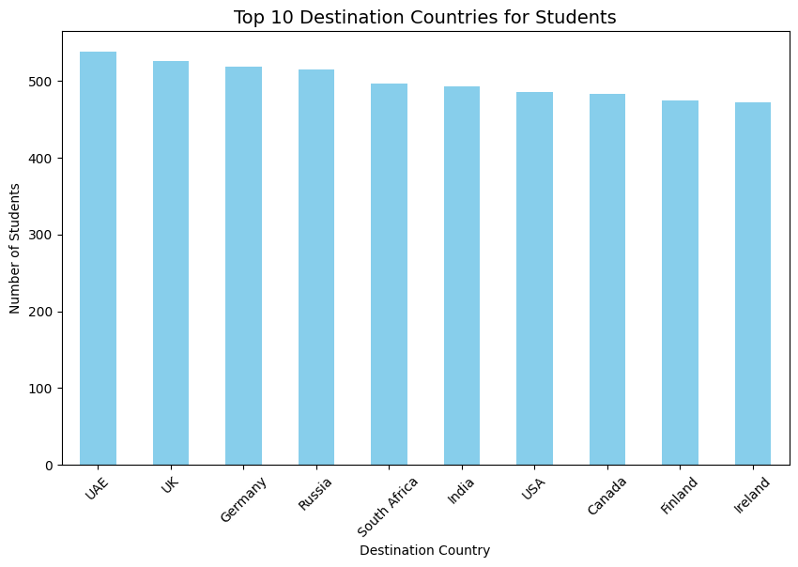
Top 10 Destination Countries
UAE leads with just over 540 students.
The UK and Germany follow, each with more than 520 students.
Ireland and Finland attract under 480 students, ranking lowest among the top 10.

Slide 9
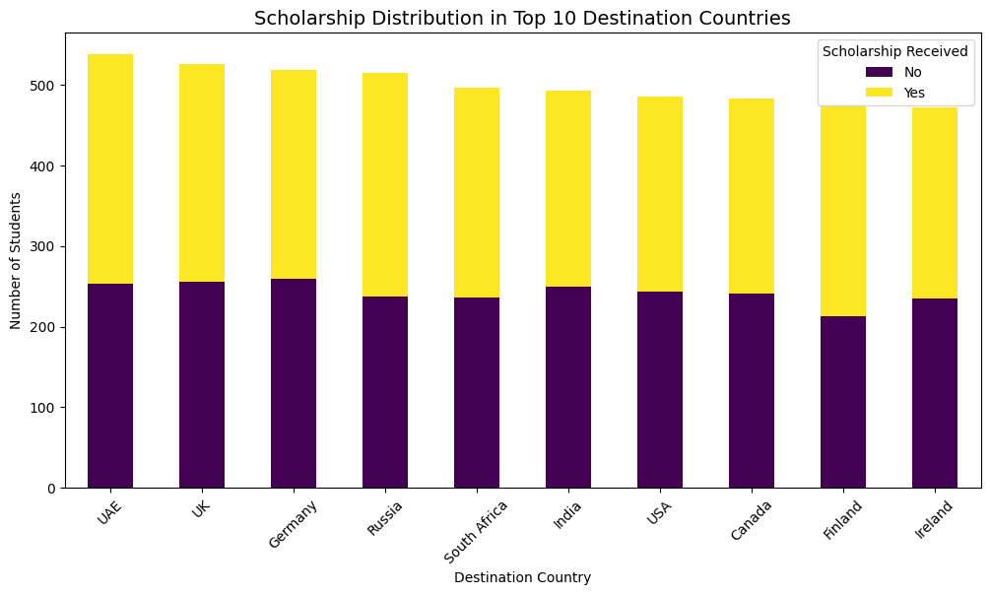
Scholarship Distribution by Destination Country
In all the top 10 countries, most students receive scholarships (yellow bars are greater than purple bars).
The UAE, UK, and Germany offer the most scholarships and have the largest student populations.
Finland and Ireland have fewer scholarships and a smaller gap between recipients and non-recipients

Slide 10
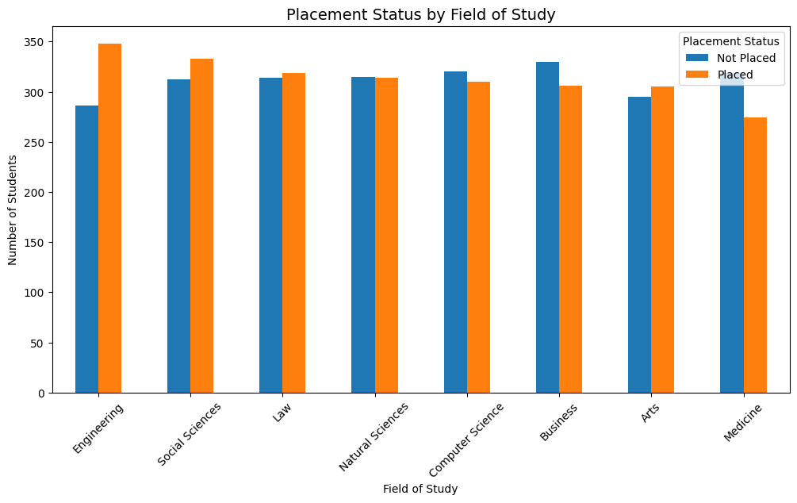
Placement Status by Field of Study
Engineering shows the largest gap favoring placed students, indicating strong employability.
Medicine and Arts have more not placed than placed students, reflecting greater job placement challenges.
Both Medicine and Arts display nearly equal numbers of placed and not placed students, suggesting moderate placement success.

Slide 11
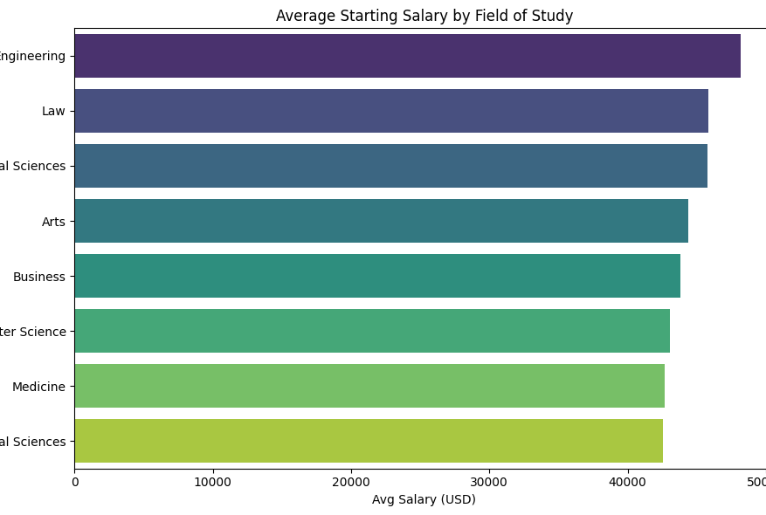
Average Starting Salary by Destination Country
Engineering graduates have the highest average salary at about $48,000, surpassing other fields.
Both technical and non-technical disciplines offer promising salaries around $45,000.
Meanwhile, fields with the lowest starting salaries range from $42,000 to $43, indicating limited earning potential compared to technical and legal fields.

Slide 12
Models and Results
Notes:
Models Used, Model Results

Slide 13

Models Used
Predictive Modeling Techniques
  Three key models were used: Ridge Regression for linear baseline, Random Forest for complex interactions, and XGBoost for high performance.
Model Evaluation Metrics
  Models were evaluated using MAE, RMSE, and MAPE to measure prediction accuracy and error rates.
Chronological Data Splitting
  Chronological splitting was applied to simulate real-world forecasting by training on historical data and testing on future data.
Notes:
Three predictive modeling techniques were employed: Ridge Regression, Random Forest Regressor, and XGBoost Regressor. Ridge Regression served as a linear baseline, offering interpretability but limited in capturing nonlinear relationships. Random Forest, a tree-based ensemble model, effectively handled complex interactions and categorical encodings, providing robust generalization. XGBoost, a gradient boosting method, delivered strong performance and feature importance insights. Models were evaluated using Mean Absolute Error (MAE), Root Mean Squared Error (RMSE), and Mean Absolute Percentage Error (MAPE). Chronological splitting was applied to mimic real-world forecasting, training on historical data and testing on future periods.

Slide 14
Model Results
Model | MAE | RMSE | MAPE
Ridge Regression (≤2019) | 2.65 | 3.37 | 30.08%
Random Forest (≤2019) | 2.61 | 3.32 | 29.72%
XGBoost (≤2019) | 2.68 | 3.39 | 29.75%
Ridge Regression (≤2020) | 2.60 | 3.27 | 27.09%
Random Forest (≤2020) | 2.53 | 3.21 | 27.22%
XGBoost (≤2020) | 2.70 | 3.40 | 27.68%
Notes:
Random Forest consistently outperformed other models, achieving the lowest MAE (2.53) and RMSE (3.21) when trained through 2020, with a MAPE around 27%. XGBoost demonstrated similar accuracy and robustness, while Ridge Regression lagged due to its inability to capture nonlinear patterns. Feature importance analysis revealed that scholarship rate and placement rate were the strongest predictors, followed by academic metrics like test scores and GPA. Country-level factors had moderate influence, while year of enrollment played a minor role. Incorporating pandemic-era data improved model adaptability and accuracy, highlighting the need to include policy and economic variables for future forecasting.

Slide 15
Conclusion
Notes:
Key Takeaways and Recommendations

Slide 16

Key Takeaways and Recommendations
Model Performance
  Tree-based models like Random Forest and XGBoost capture nonlinear interactions better than linear models in student migration forecasting.
Key Predictors
  Scholarships and placement opportunities are the most influential factors, with academic metrics also playing a significant role.
Pandemic Data Impact
  Incorporating pandemic-era data improved forecasting robustness and accuracy, highlighting adaptable strategy needs.
Strategic Recommendations
  Enhance scholarships, support employment pathways, leverage analytics, consider visa reforms, and focus on competitive regions.
Notes:
Tree-based models, particularly Random Forest and XGBoost, outperform linear models in forecasting student migration, confirming the importance of capturing nonlinear interactions among academic, financial, and country-level factors. Scholarships and placement opportunities emerged as the most influential predictors, while academic metrics also played a significant role. Incorporating pandemic-era data improved model robustness and accuracy, emphasizing the need for adaptable forecasting strategies. Recommendations include enhancing scholarship initiatives, supporting post-study employment pathways, and leveraging predictive analytics for institutional planning. Policymakers should consider visa reforms and bilateral agreements to stabilize student mobility, while universities should focus on high-potential regions and monitor placement outcomes to maintain competitiveness.

